Slide 1
Project 4: Venue Sort

Slide 2
Project 4: Venue Sort
This project is an exercise in
Using C++ strings.
Operator overloading.
Text File Input

Slide 3
Operator Overloading
Modify the Venue class from the Ticket Printer project by adding a < operator.
http://www.csee.usf.edu/~turnerr/Object_Oriented_Design/Downloads/2016_02_19_In_Class/
If two venues have different zip codes, consider the one with the smaller zip code smaller.
If two venues have equal zip codes, consider the one whose name comes first alphabetically as smaller.
< operator for class string
Let the < operator for Venue implement these rules.

Slide 4
Text File Input
Read a text file with information about venues.
Create a Venue object for each venue in the file.
Store the addresses of the Venue objects in an array of Venue*
Handle a variable number of venues in the file.
Maximum of 100.
A sample input file is available in the Downloads area of the class web site.
You can use this file for testing, but you program should work with any such file with any number of venues, up to the max of 100.

Slide 5
Program Flow
Prompt the user for filename.
Read the file and create array of Venue*
Output the venues to the screen as read.
Sort the array into increasing order, using the < operator for class Venue.
Be sure to compare the Venue objects, not the pointers.
Sort the pointers.
Output the venues to the screen as sorted.

Slide 6
Sample Input File
Carol Morsani Hall
1010 North W.C. MacInnes Place
Tampa
FL
33602
Tampa Theatre
711 N Franklin Street
Tampa
FL
33602
Midflorida Credit Union Amphitheatre
4802 N US Highway 301
Tampa
FL
33610
Amalie Arena
401 Channelside Dr
Tampa
FL
33602
The Tampa Improv
1600 E 8th Ave
Tampa
FL
33605
Skipper's Smokehouse
910 Skipper Road
Tampa
FL
33613
http://www.csee.usf.edu/~turnerr/Object_Oriented_Design/Downloads/Project_4_Venue_Sort/

Slide 7
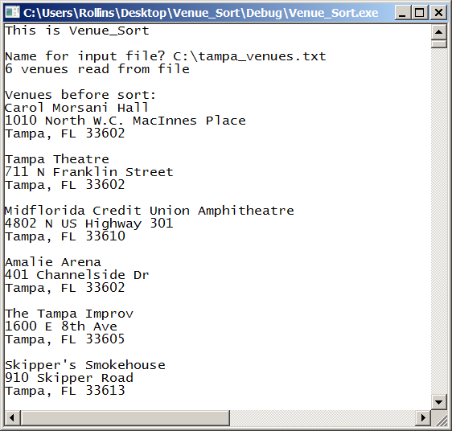
Sample Run

Slide 8
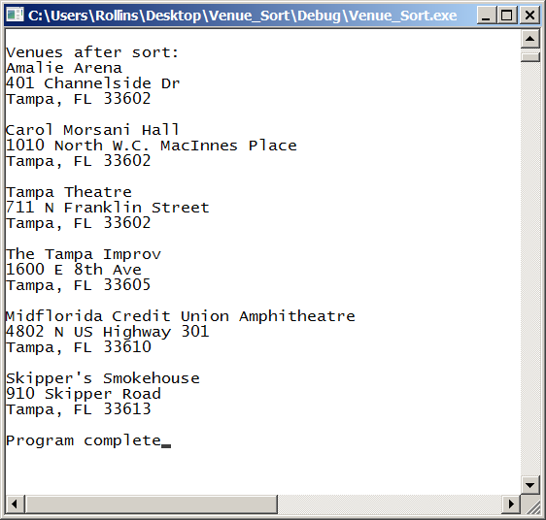
Sample Run -- Continued

Slide 9
Development Environment
You may develop your program on any system you like.
But you should test the finished program on Circe.
That’s where we will grade it.
The same source files should compile and run on either Windows or Linux.

Slide 10
Ground Rules
You may work with one other person.
OK to work alone if you prefer.
If you do work as a pair
Work together!
Both members are expected to contribute.
Submit a single program.
Both members should understand the program in detail.
Do not share your code with other students.
Before or after submitting the project.
It is OK to discuss the project.
Do not copy any other student’s work.
Don’t look at anyone else’s program.
Don’t let anyone look at your program.

Slide 11
Ground Rules
Except for code posted on the class web site
Do not copy code from the Internet
or any other source.
Write your own code.

Slide 12
Submission
Project is due by 11:59 PM, Thursday night, March 10
Deliverables:
Use Canvas Assignments to submit your program.
Source code only.
Zip the source files for submission.
Put your source files into a folder
Use the Windows “Send to Compressed Folder” command.
If you work with another student, include both names in the Canvas submission comments.
Other student should submit just a comment including both names.
End of Presentation

